Slide 1
11.4
Released 10th of March
Notes:
Hi there! My name is XXXX and I will tell you all a bit about the latest & greatest from the openSUSE Community, openSUSE 11.4!

Slide 2
LibreOffice
Scribus 1.4
Firefox 4
KDE SC 4.6
GNOME 2 and 3
Notes:
This release came out in the beginning of March. First to ship a stable LibreOffice in a major distro release; the same with Firefox 4.0, Scribus 1.4 and KDE SC 4.6. Our 8 month release schedule ensures we have stable software but we also ship the latest where needed!

Slide 3
Tumbling
and
Rolling
YOUR
own
build
.
.
.
Notes:
We also introduced Tumbleweed, a rolling release on top of openSUSE.
Packman has updated their repository layout and of course you can use 11.4 from SUSE Studio!

Slide 4
Deeper
Down
systemd
Kernel 2.6.37
Zypper
ATI/NVIDIA
YaST Encryption
Notes:
Zypper package management super fast: downloads 'delta' (difference between old and new package) from different servers at same time!
YaST can handle fully encrypted system during installation
Kernel 2.6.37 supports Broadcom WIFI (many laptops have this chip) and there is better support for NVIDIA and AMD/ATI videocards.
Also, openSUSE has added some extra peformance patches to the kernel.
11.4 starts up faster and includes experimental GRUB2 & systemd

Slide 5




CHOICE
is
GOOD
Notes:
Let's begin by talking about desktop.
openSUSE believes you are not stupid. We believe choice and flexibility are good. So while we try to keep things as easy as possible, we don't go any further than that. Choose a default or adapt it to your personal needs.
We ship 4 major desktops products: KDE's Plasma desktop and netbook, GNOME, XFCE and LXDE. Pick!

Slide 6
CHOICE
is
GOOD
Notes:
Let's start with the default openSUSE desktop, KDE/

Slide 7
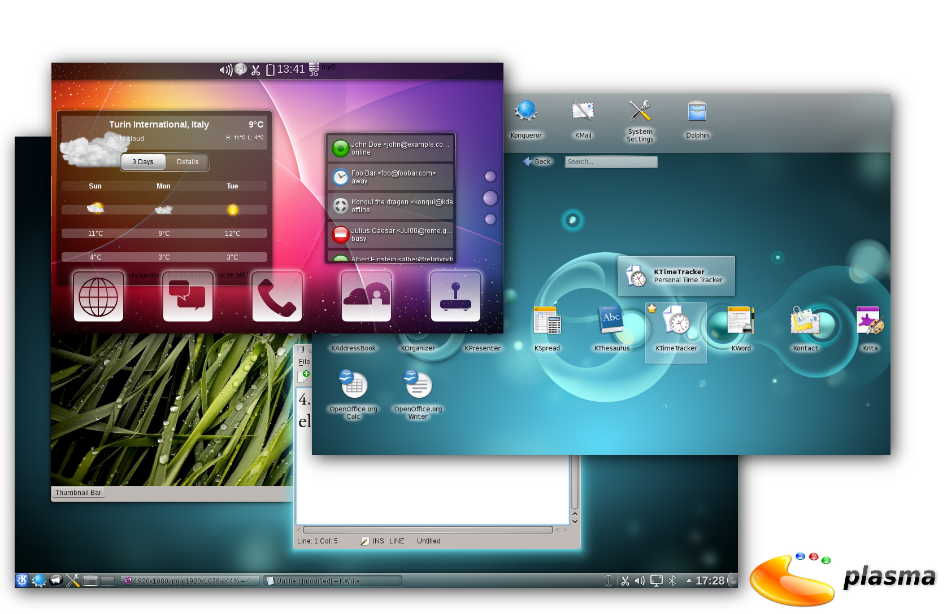
Plasma = flexibility
Notes:
KDE offers a few different desktop workspaces. Based on their flexible “Plasma” technology, they offer “Plasma Desktop”, “Plasma Netbook” and upcoming are “Plasma Mobile”, “Plasma Tablet” and “Plasma Media center”. This picture shows the mobile, netbook and desktop workspaces.

Slide 8
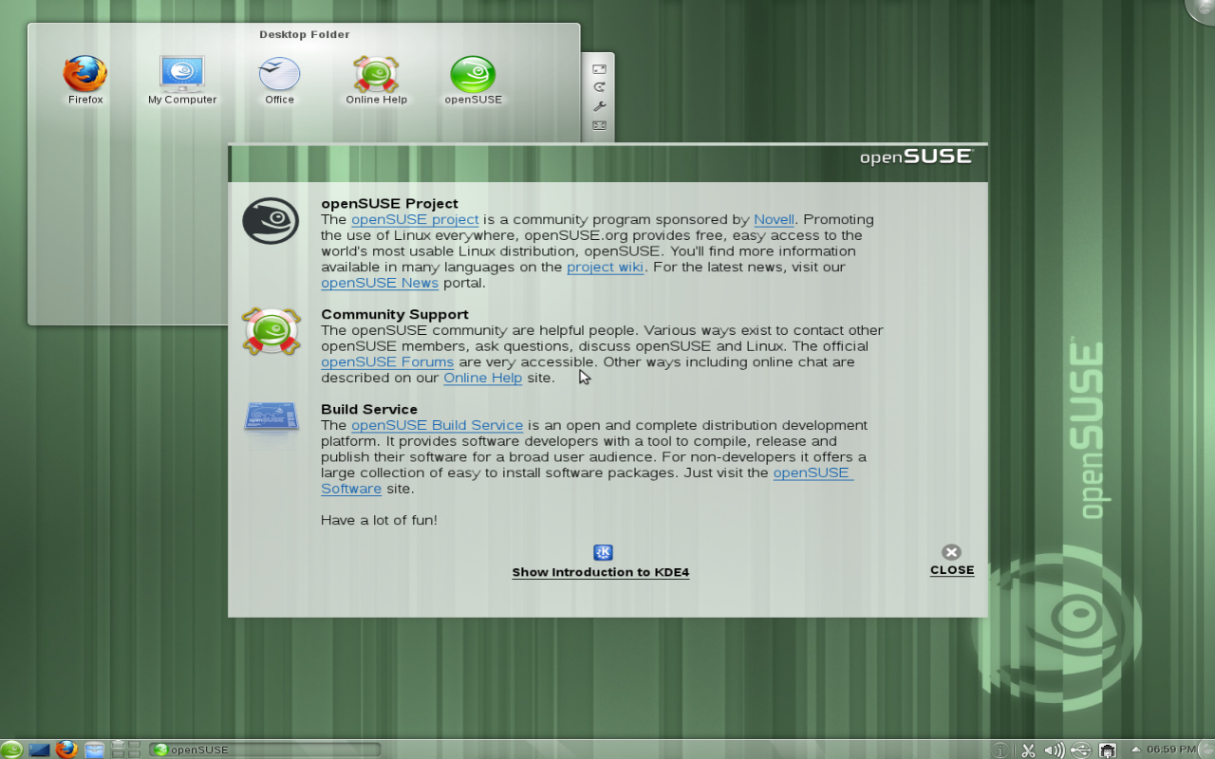
Notes:
OpenSUSE ships currently the Desktop and Netbook interfaces.

Slide 9
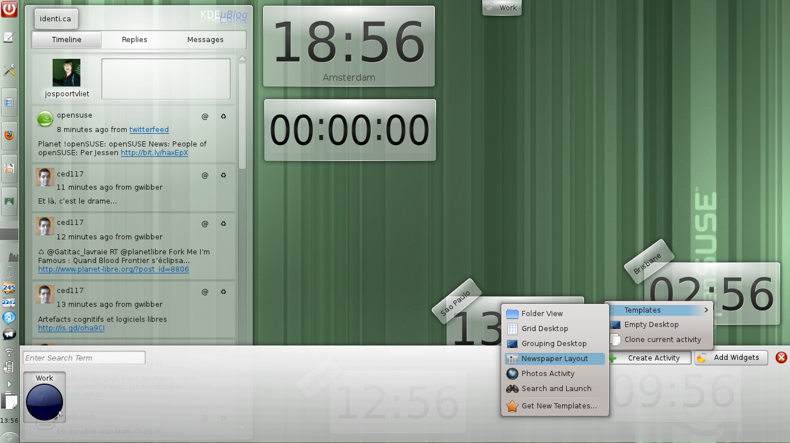
Notes:
Plasma Desktop introduces much improved Activities.
Activities are a way to 'split up your work' according to tasks you have. Activities start and stop applications depending on what you are doing.
The activity interface has been improved a lot.

Slide 10
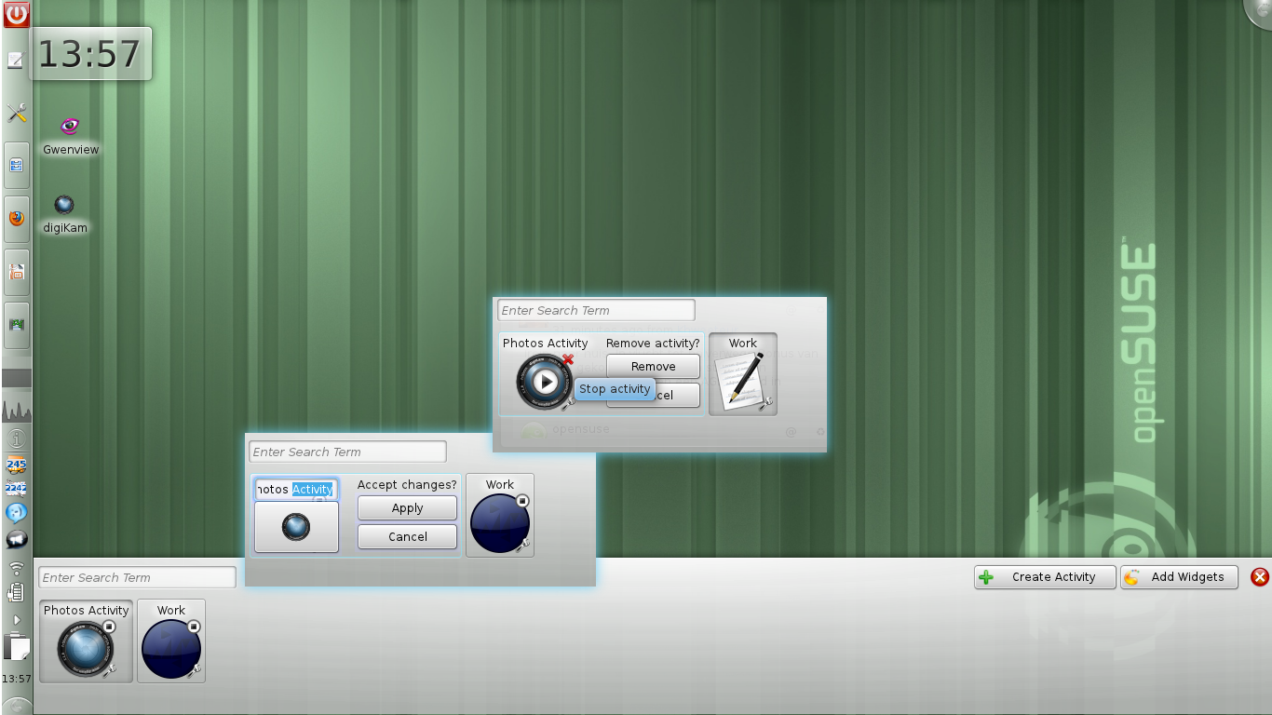
Notes:
Say you have two main tasks at work, writing code and working on some graphics. You can create a work and a graphics editing activity. The desktop itself (and it's widgets) are unique per activities.

Slide 11
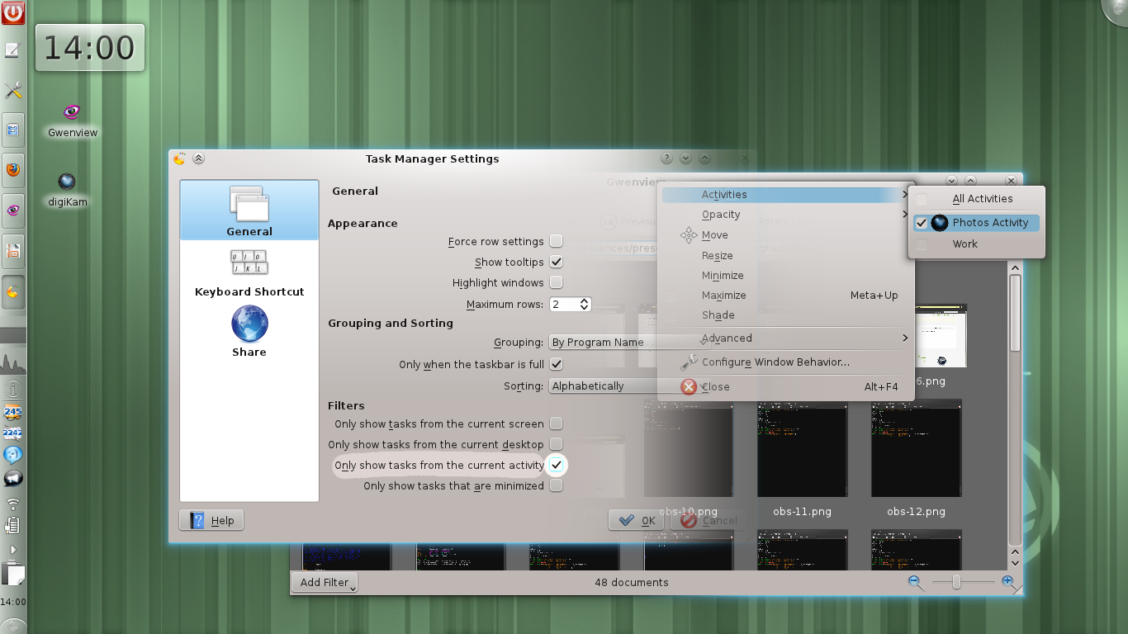
Notes:
Plasma Desktop allows you to associate application windows to each of these tasks. If you stop an activity, the applications are closed but will be restored when you start it again, just like you left them. This makes use of the “session support” which most Linux applications have.

Slide 12
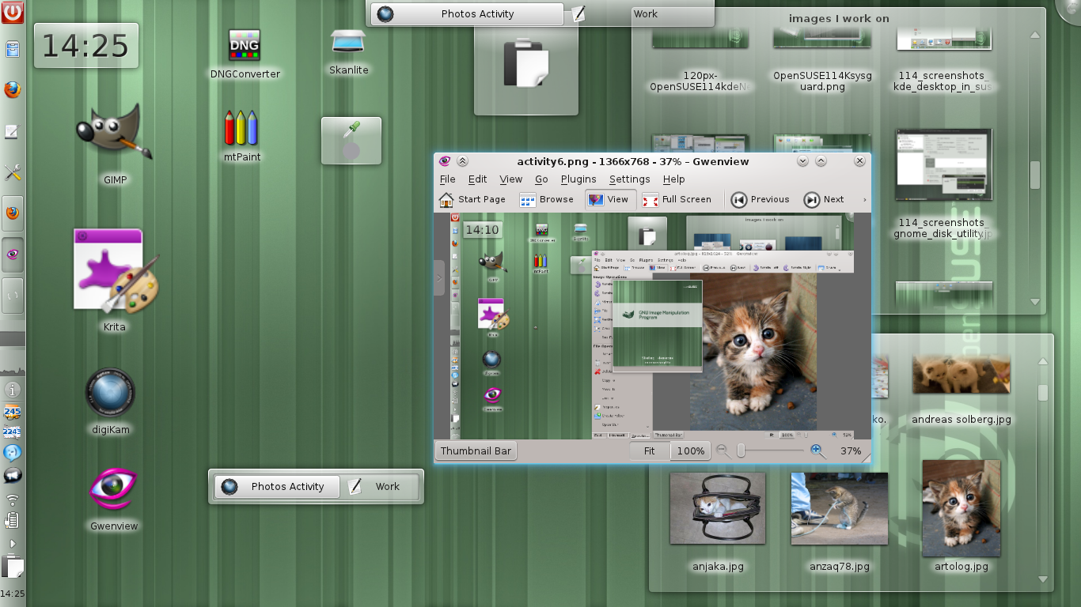
Notes:
Think of activities as “virtual desktops done right”!
Activities were experimental in previous Plasma desktop versions but are quite usable right now.
On the desktop is an activity switching applet (which is also in the auto-hiding panel on top of the screen).

Slide 13
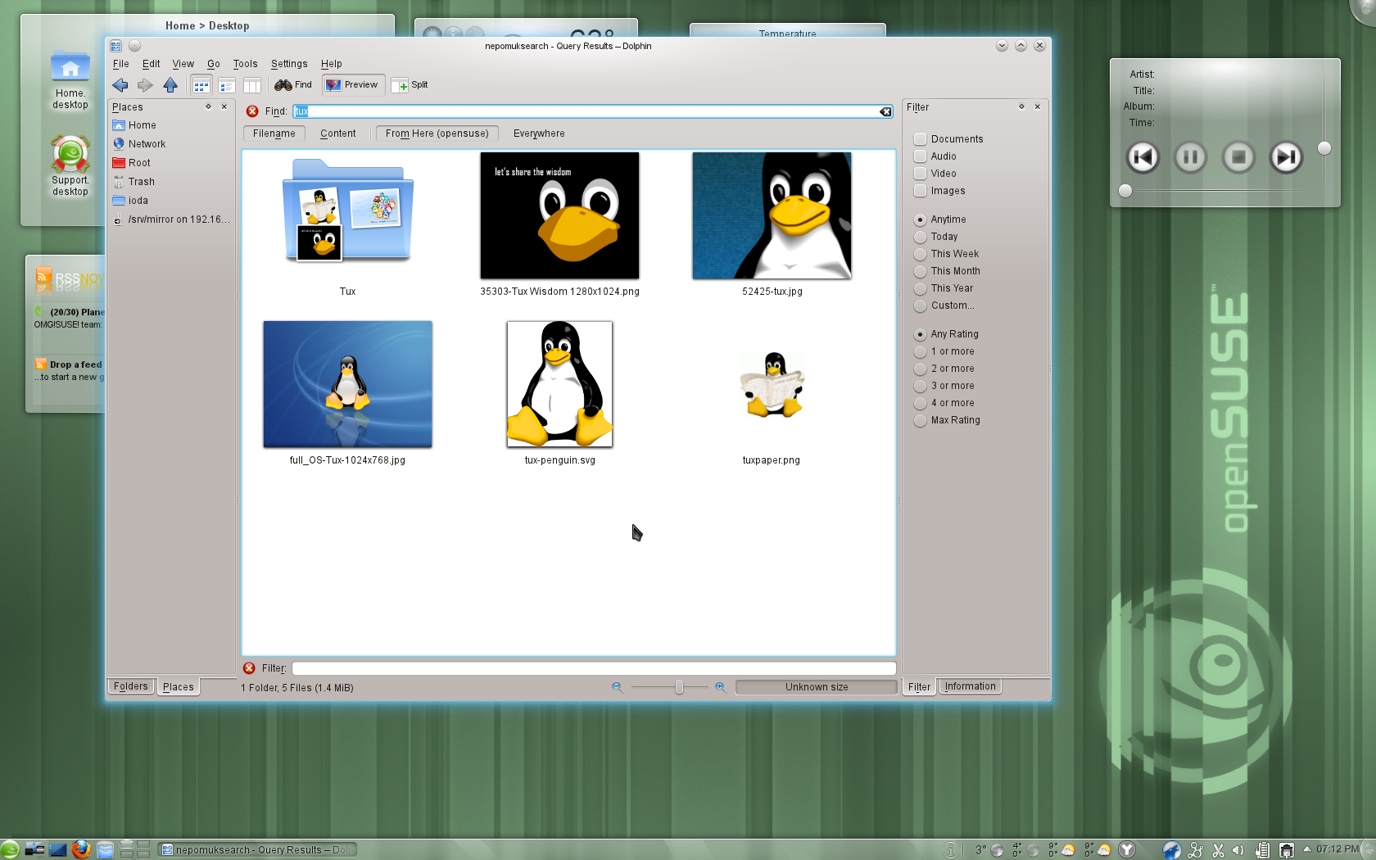
Notes:
Of course there are plenty of other improvements. Dolphin has much improved search integration including the 'facetted browsing sidebar' which allows you to filter files in a folder or search results based on properties like tags or ratings.

Slide 14
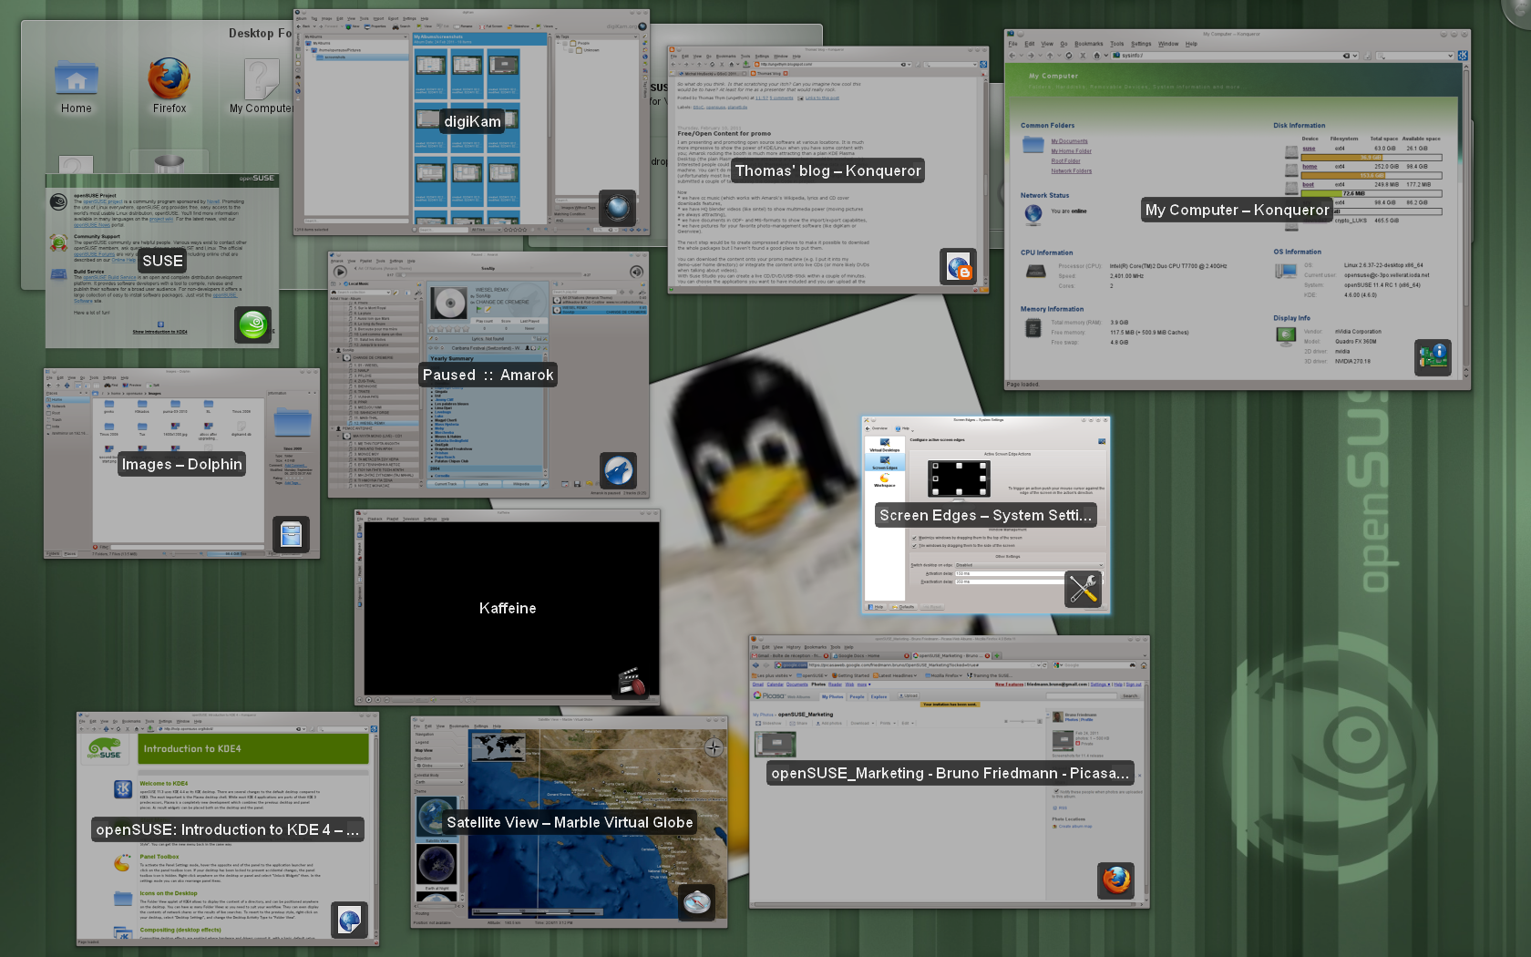
Notes:
KWin has become faster, can handle more graphics cards and now has scripting support.
Various Plasma widgets have been improved, like the taskbar, which now allows you to 'pin' a task to it which provides you a launcher when the app is not running.

Slide 15
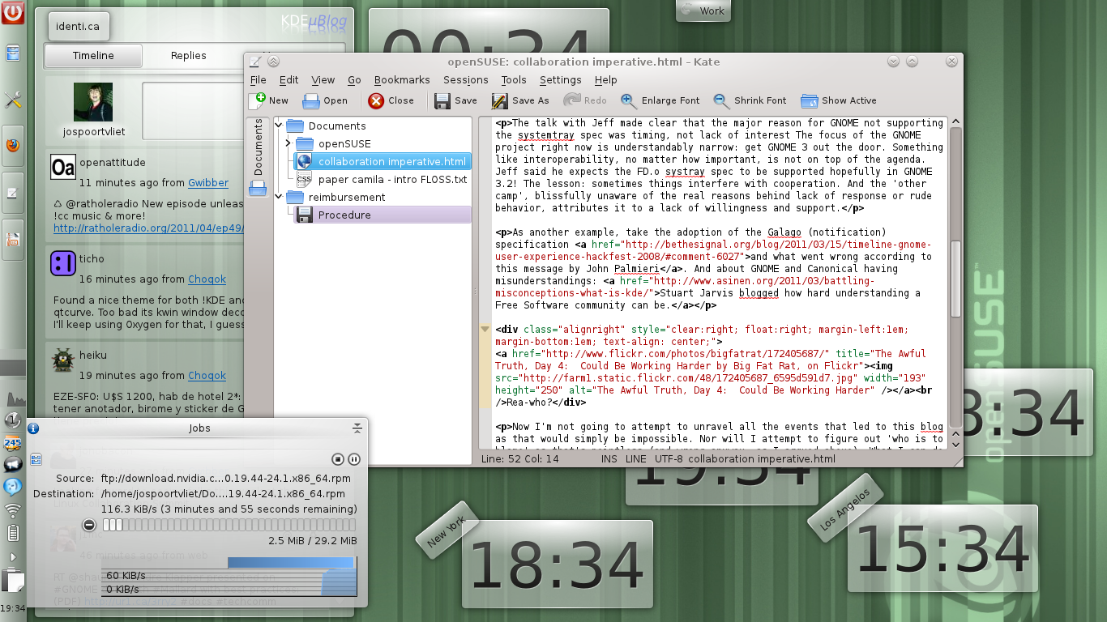
Notes:
You can now drag and drop notifications to anywhere you want them to appear and the file progress dialogs show a graph of the download speed.
Advanced text editor Kate has SQL support and a new GDB plugin

Slide 16
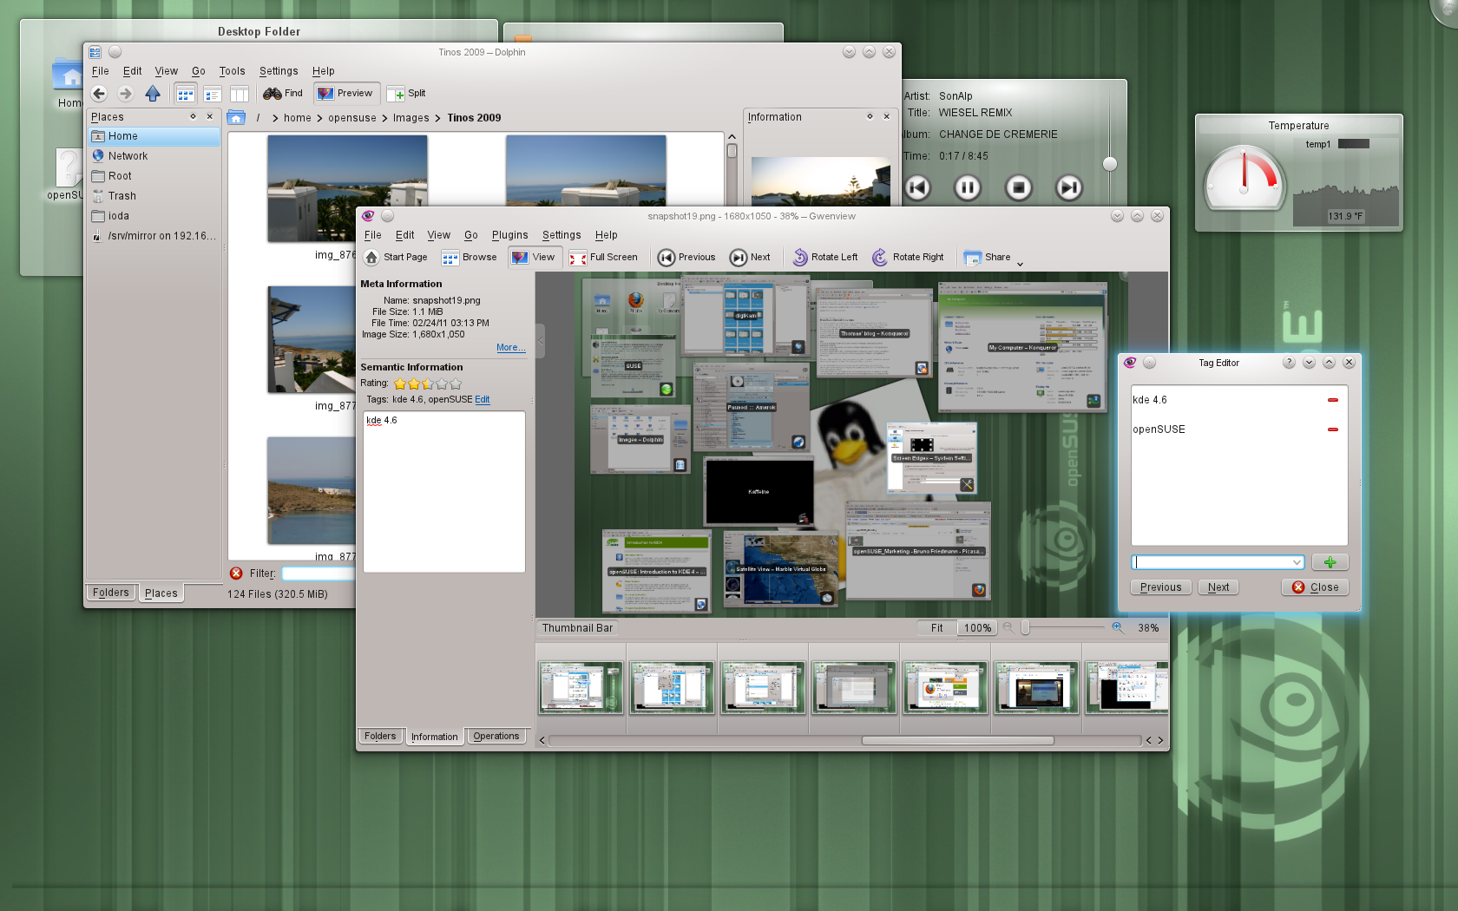
Notes:
The social sharing plugins like Flickr, Facebook and Picasaweb are now easy to reach from Gwenview and other applications. Faster and easier sharing of your pictures!

Slide 17
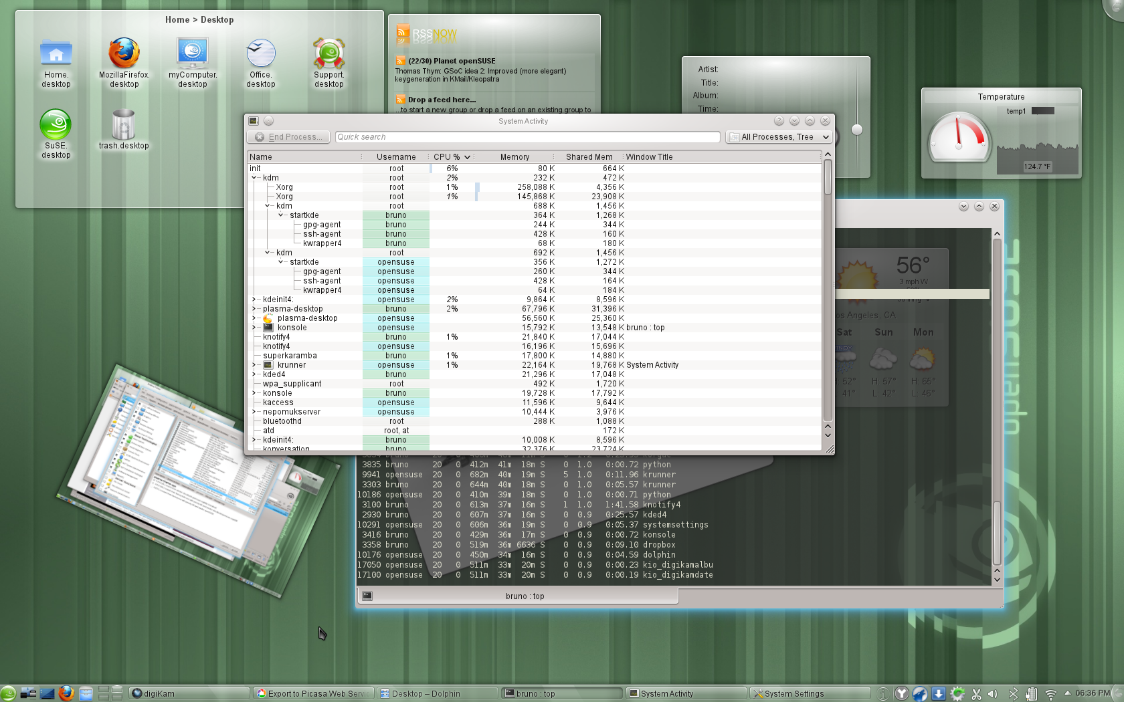
Notes:
There is now a backup tool for the metadata of Nepomuk.
Bluetooth has improved with the introduction of BlueDevil, bringing easy wizards for device pairing and file browsing integration to KDE applications

Slide 18
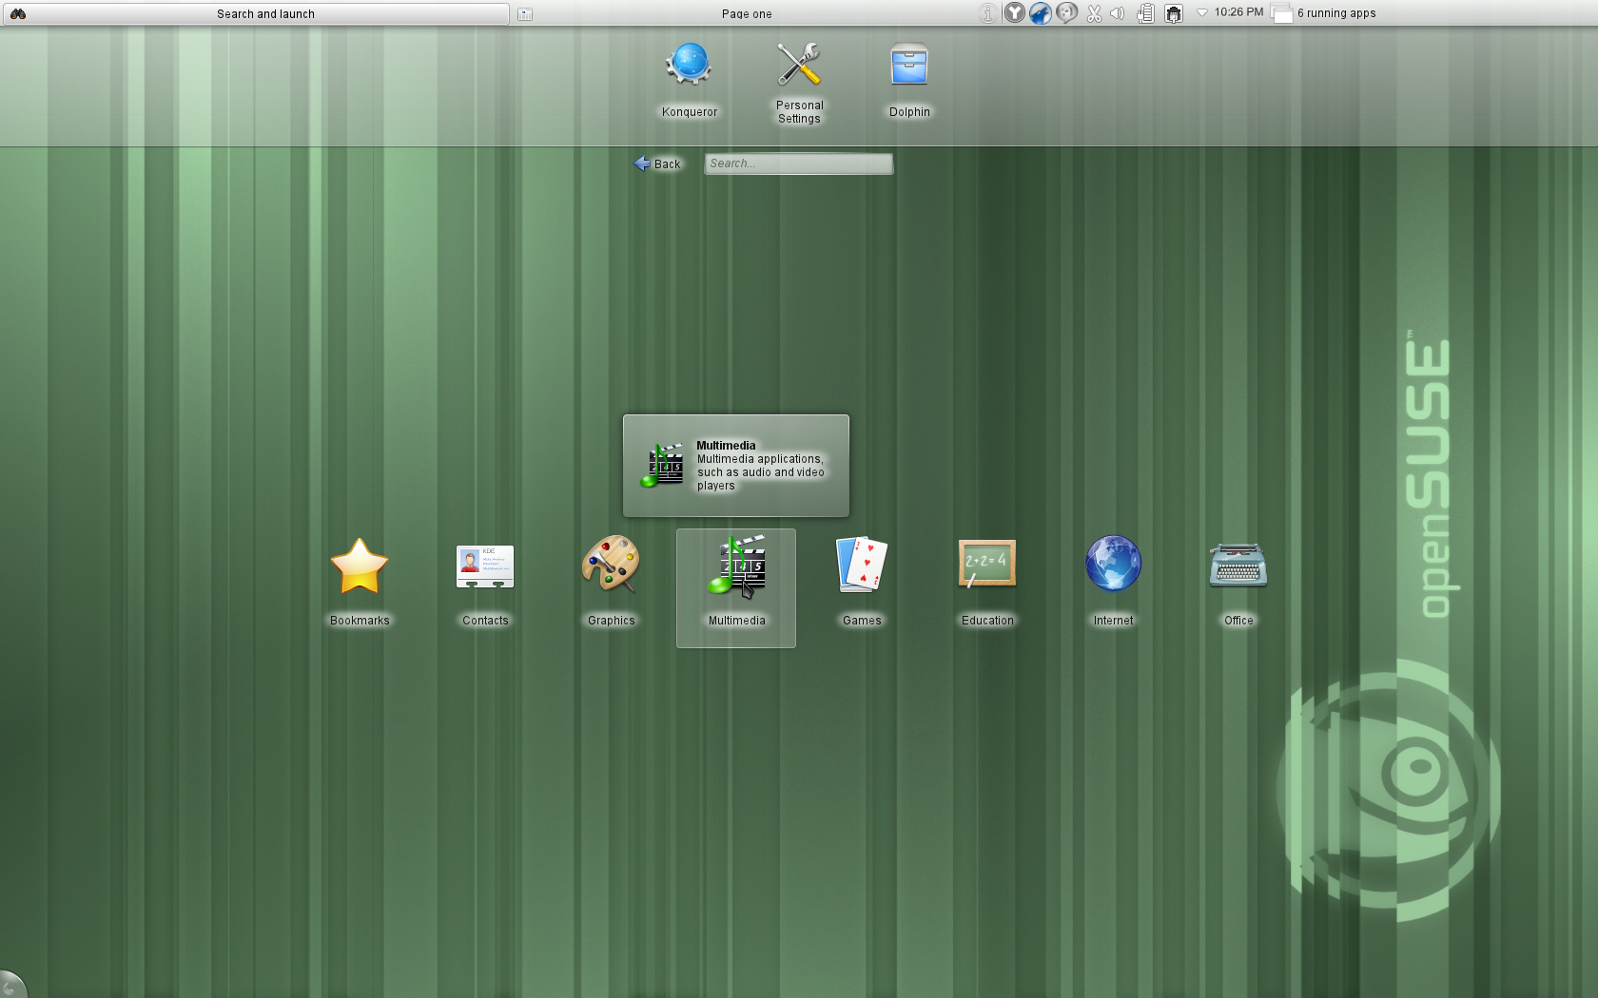
Notes:
Plasma Netbook is KDE’s workspace optimized for mobile computing devices. It has become faster and more touch friendly.

Slide 19
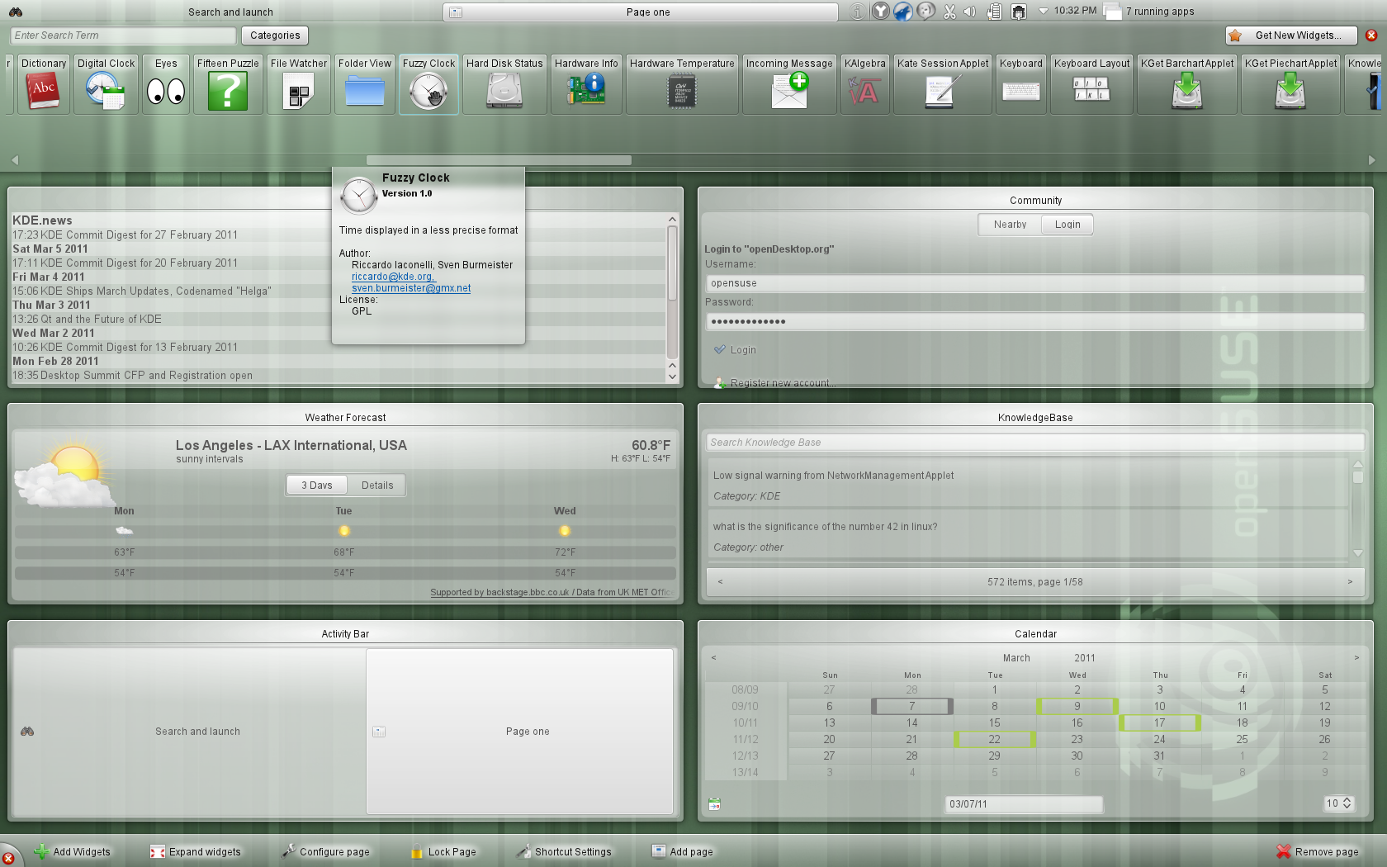
Notes:
By arranging widgets in rows, you can fit more on a small screen. But it is also usable on a large screen like the one used in this screenshot!.

Slide 20
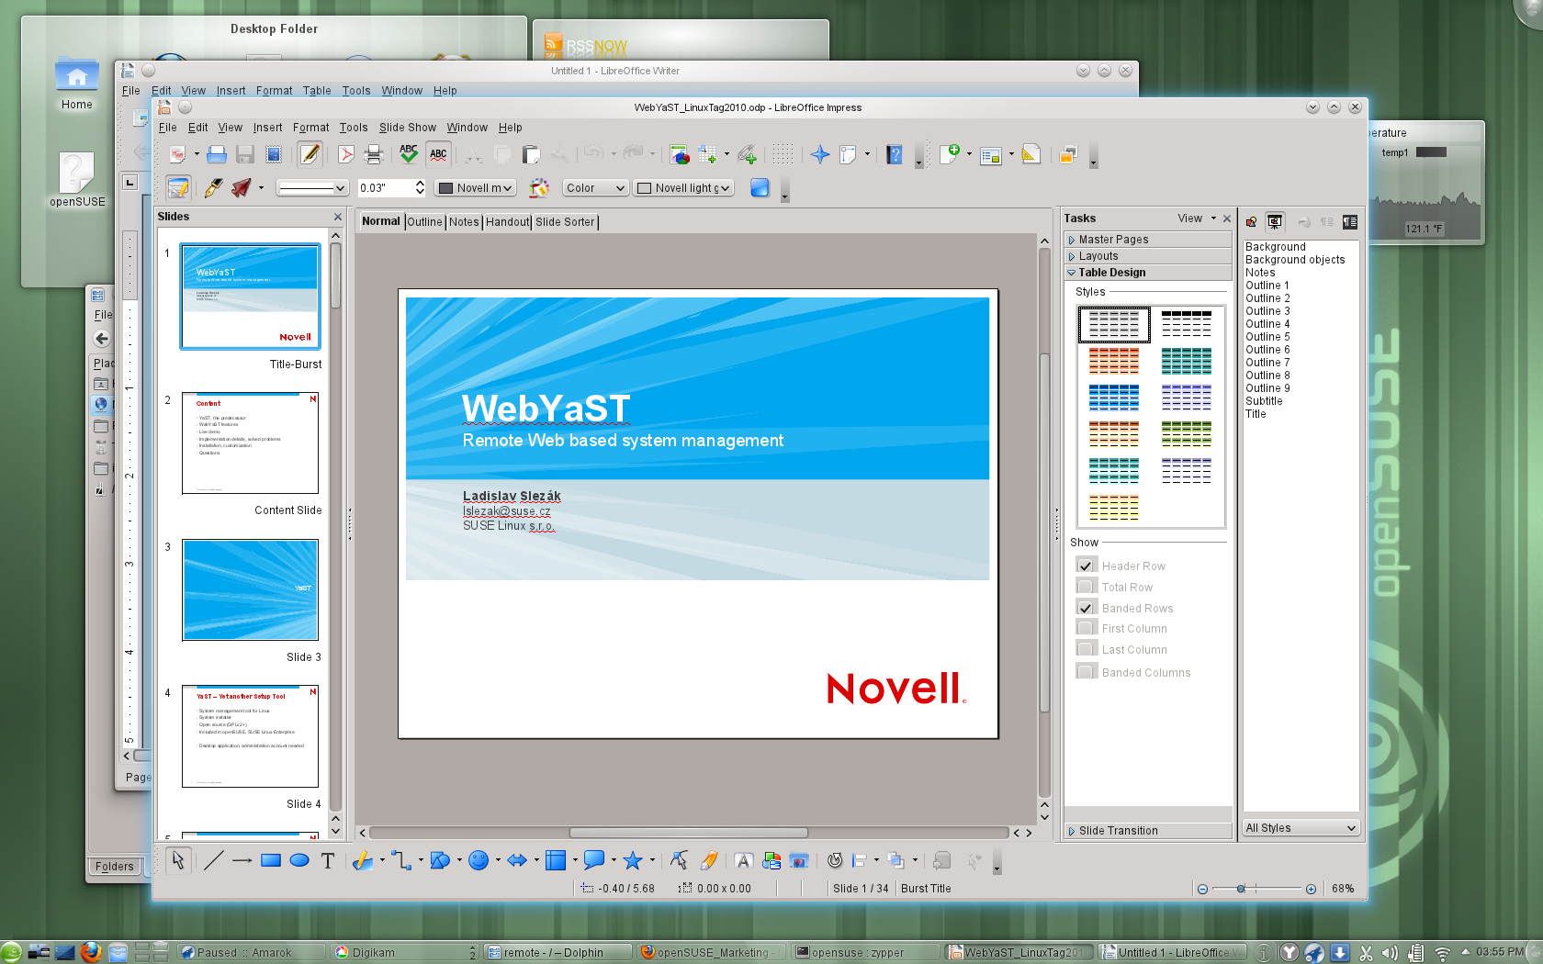
Notes:
The KDE team in openSUSE worked on integrating KDE. improved Firefox and LibreOffice integration: native file dialogs and notifications; they will use your default email client and browser. The new oxygen-gtk theme is default for GNOME applications running in a Plasma Workspace session.

Slide 21
CHOICE
is
GOOD
Notes:
Now let's move on to the second desktop in openSUSE!

Slide 22
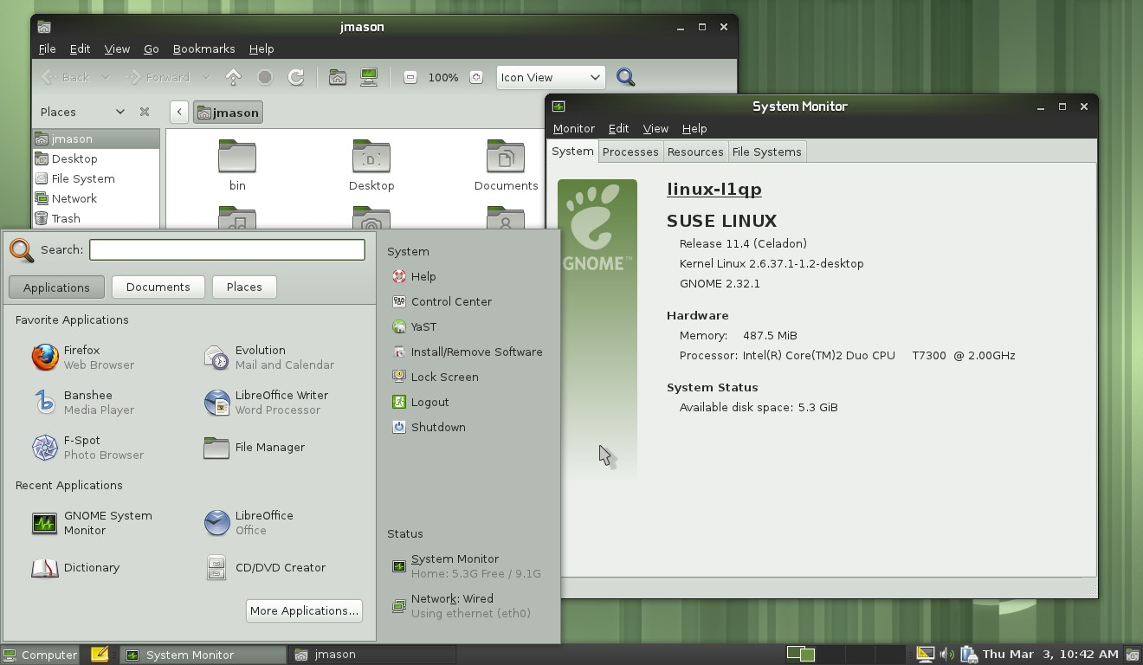
Last in the 2.32 series
Notes:
The default GNOME in openSUSE 11.4 is GNOME 2.32, the last release in the GNOME 2.x series. It is very stable and easy to use. Let's look at the biggest changes:

Slide 23
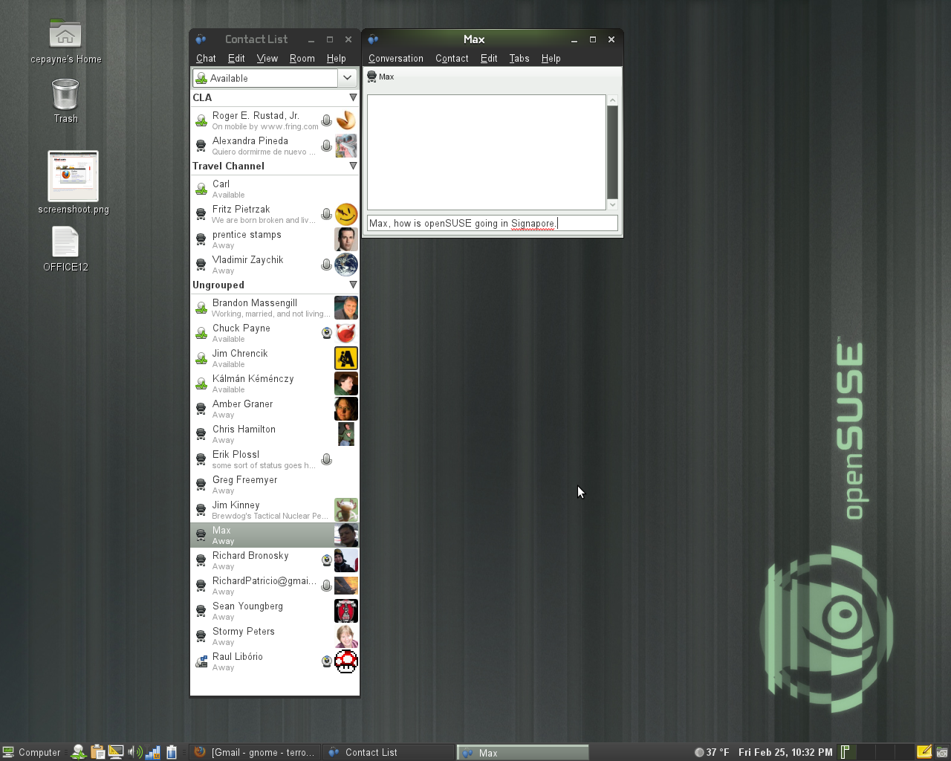
Notes:
- Updates to Empathy include user contact grouping with metacontacts, logging of chat records, and security certificate import.

Slide 24
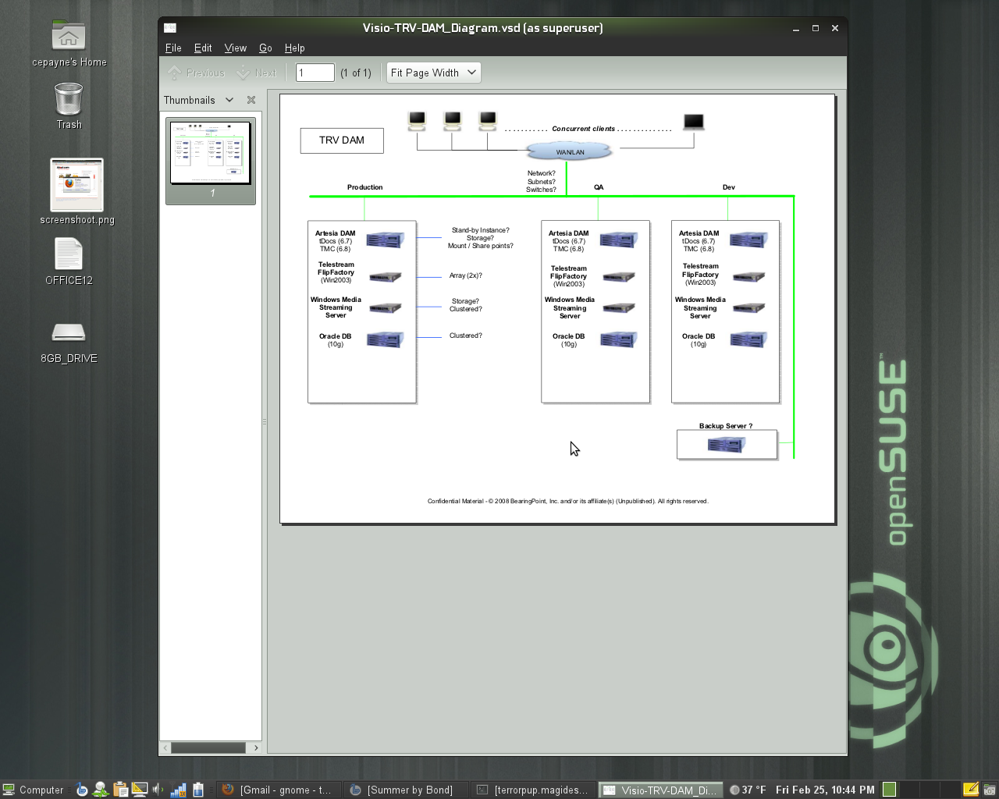
Notes:
- The Evince document viewer has improved accessibility support, maximum zoom level increased. Better Annotation support, add annotations from the side panel, change the default properties including author, color, transparency and more.
- Mousetweaks, which makes it easier to use a mouse for those users who may have limited mobility, has updated documentation

Slide 25
CHOICE
is
GOOD
Notes:
But there is a second GOME in openSUSE 11.4!
openSUSE ships with a pre-release of the upcoming GNOME 3.x Desktop (GNOME Shell)

Slide 26
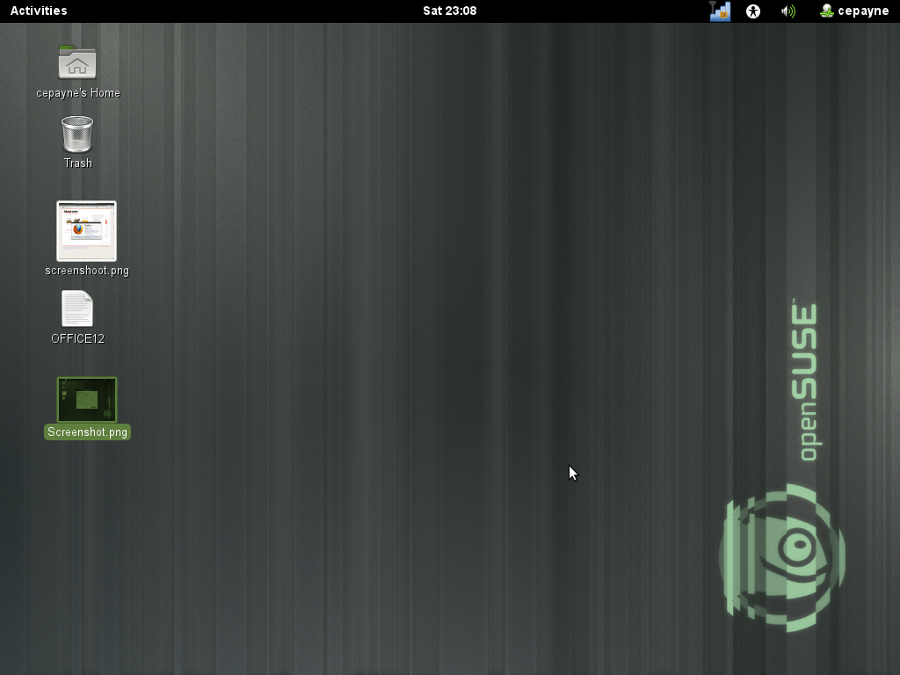
Notes:
GNOME Shell is the new face of GNOME. The goal of the project is to create a better design for the look and feel of the desktop and the key functions the desktop provides. These functions include enabling the user to find and open applications and documents, switch between various activities, and view incoming information such as chat messages or stock price updates.

Slide 27
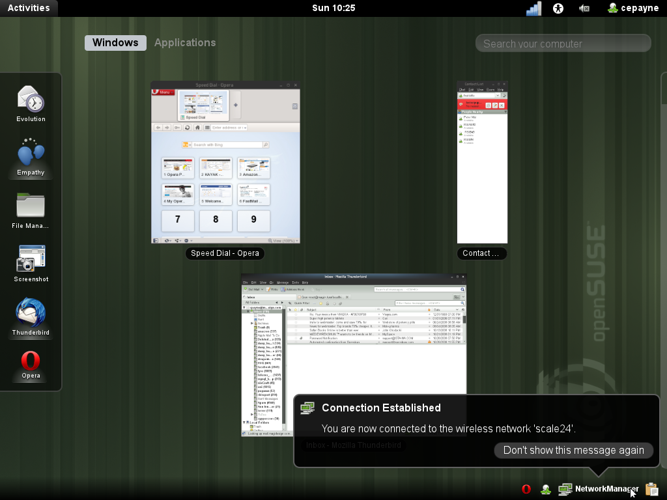
Notes:
If you click the 'Activities' button on the top left of GNOME Shell, you'll get this overview of your running applications.
You can start new apps by clicking them on the left or dragging them to a virtual desktop. Notifications are on the bottom right, as you see. You will be able to respond to things like chat there right away without starting a separate application!

Slide 28
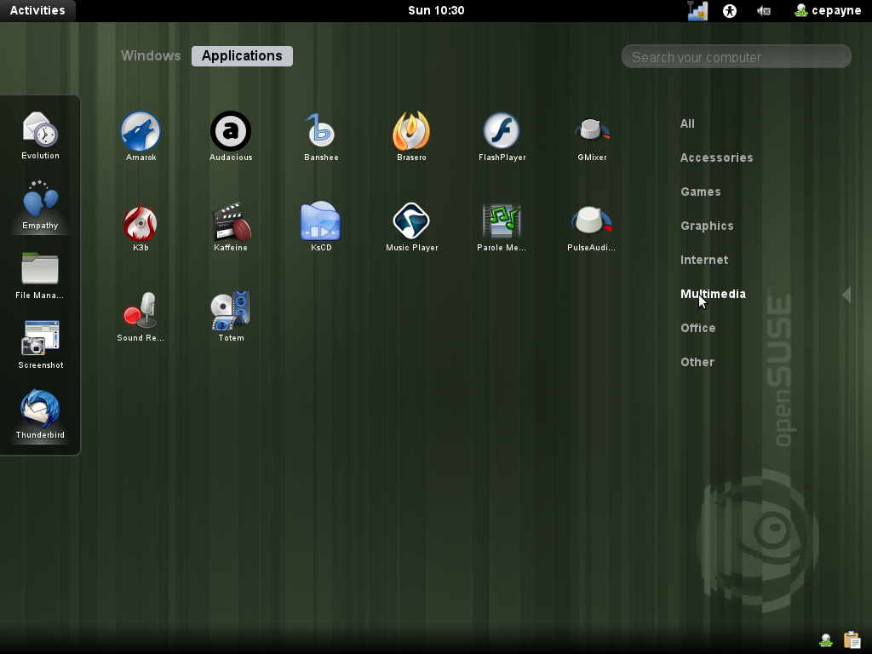
Notes:
If you use the search box you'll see GNOME Shell show you the apps you are looking for.

Slide 29
CHOICE
is
GOOD
Notes:
Now I'll quickly tell you what is new in XFCE & LXDE.

Slide 30
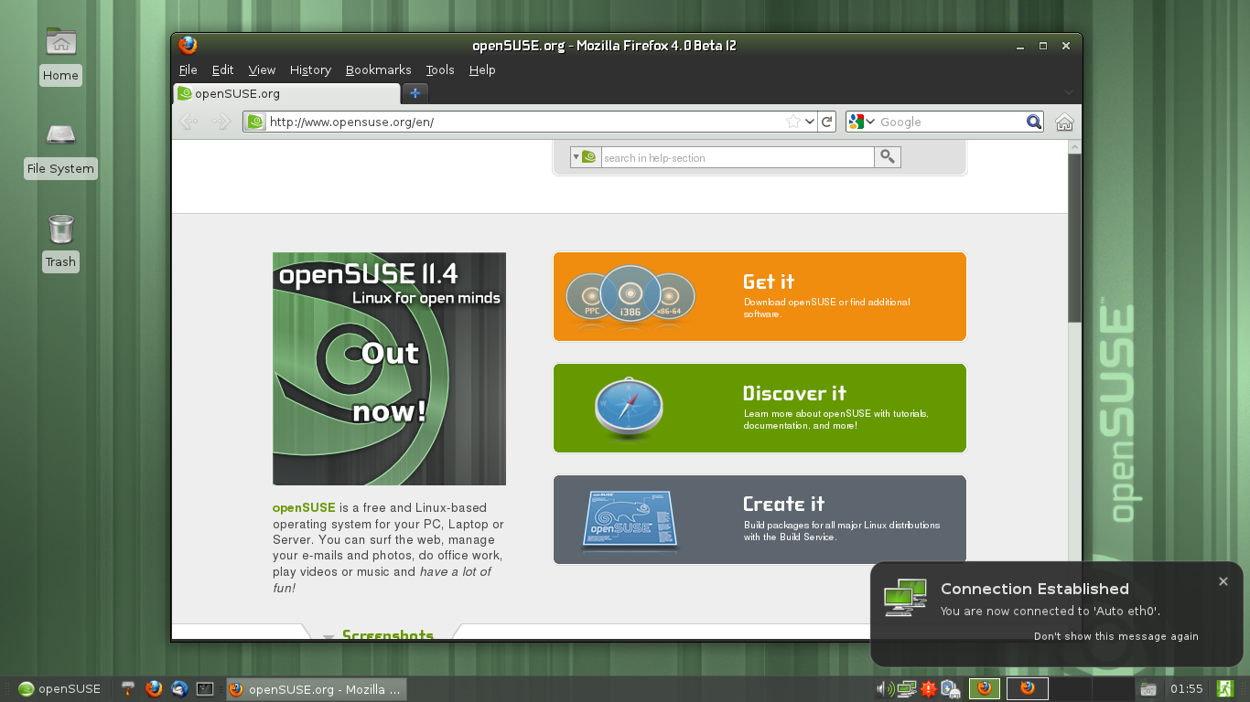
Notes:
We ship XFCE 4.8, which was years of work for the XFCE team and it is a big change in many ways! XFCE aims to provide a traditional but configurable desktop alternative to GNOME and KDE.

Slide 31
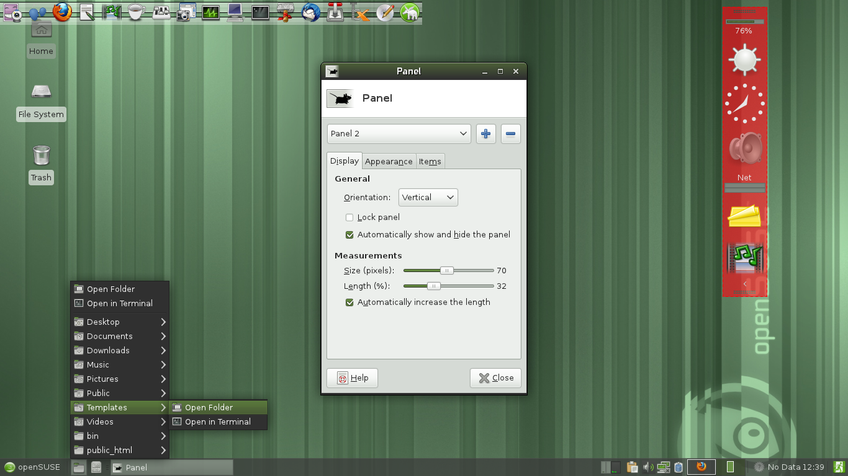
Notes:
The Panel has been rewritten and is much easier to place and change with the editor or just via drag and drop.

Slide 32
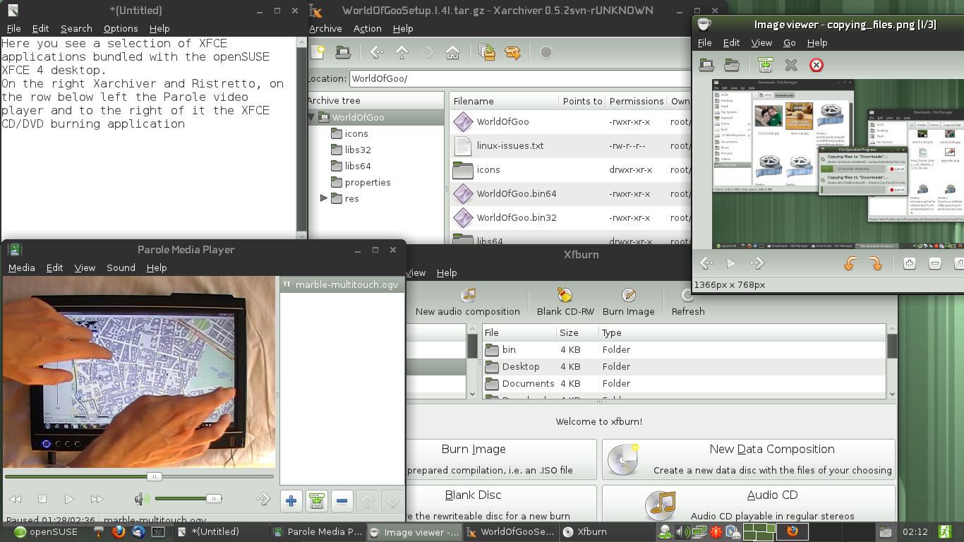
Notes:
This release brings a better Thunar filebrowser which can work with FTP, Samba and other remote protocols. And it doesn't bother you with 100 different file copy dialogs but puts them all in one window!
OpenSUSE integration is excellent with improved shortcuts and file associations

Slide 33
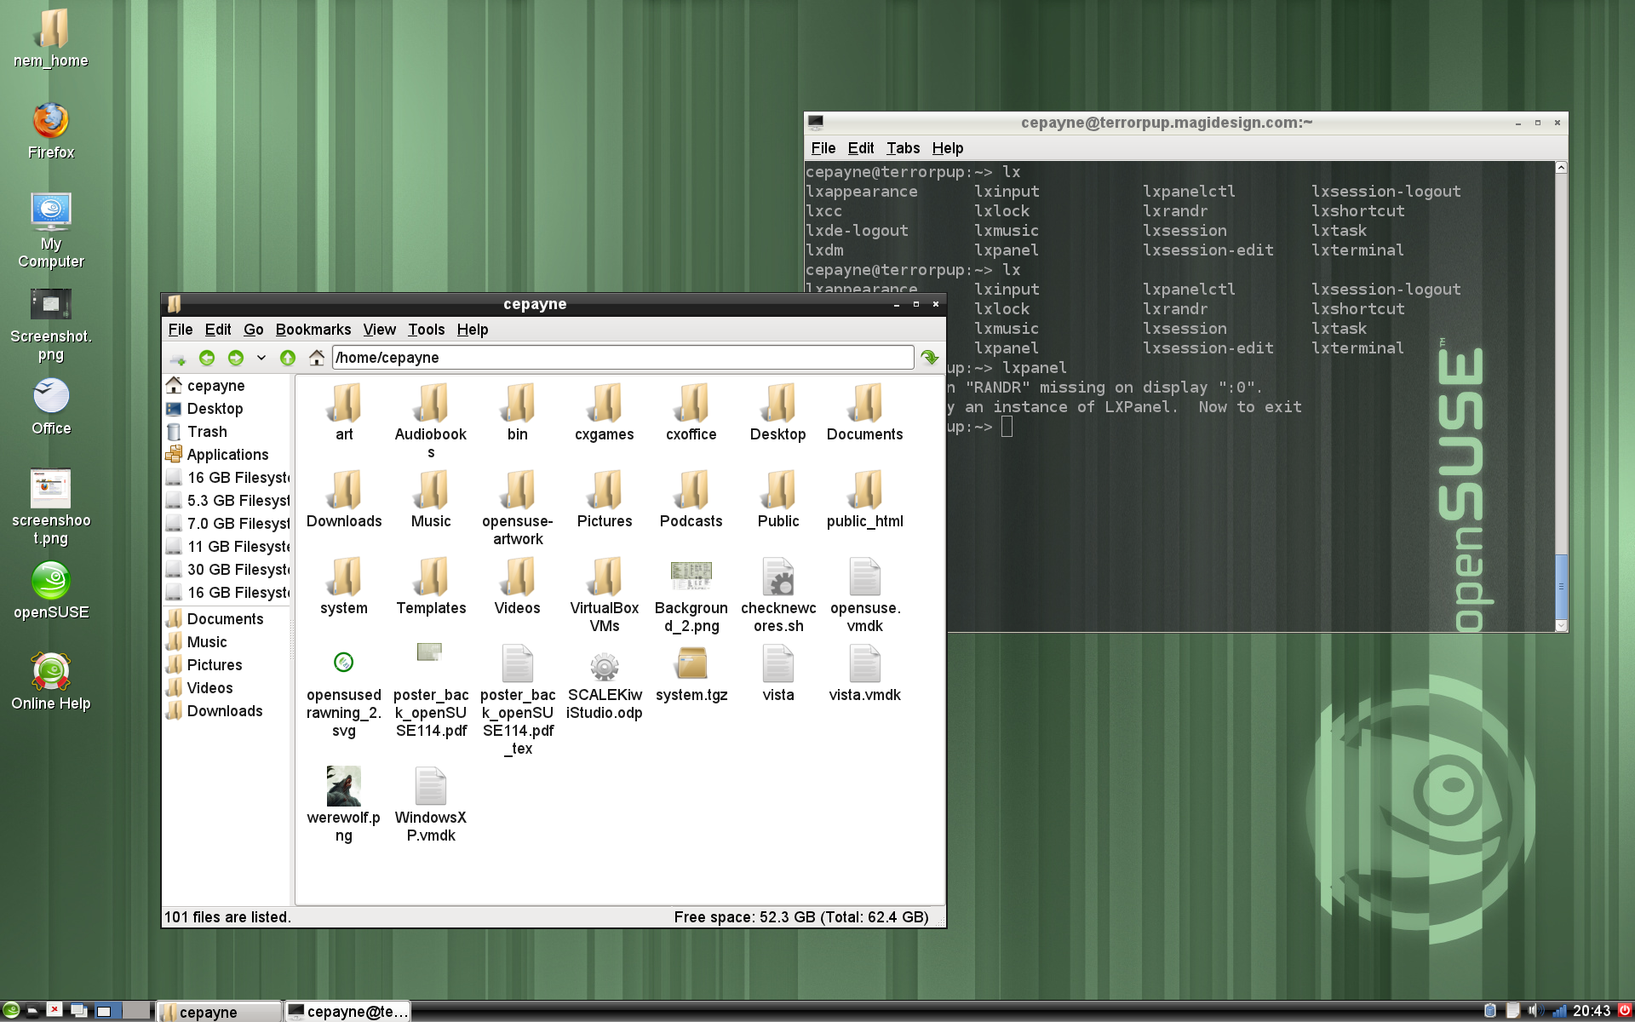
Notes:
LXDE aims to provide an extremely lightweight desktop, and succeeds on openSUSE 11.4. Booting in as little as 114MB of RAM, this GTK+ desktop provides a complete desktop experience without requiring modern hardware.

Slide 34
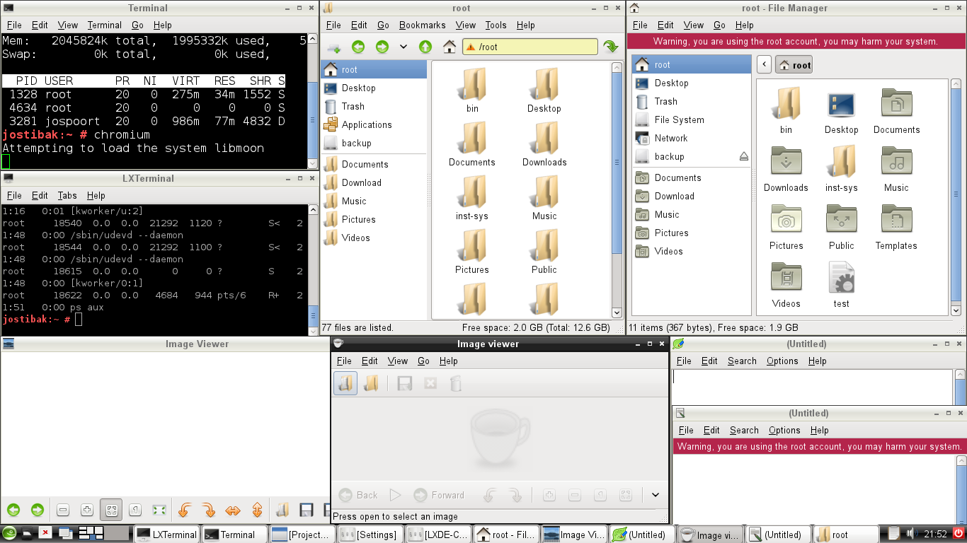
Notes:
The current release of LXDE in openSUSE introduces a number of smaller usability and stability fixes. Moreover, the LXDE team has worked on further integration in openSUSE, improving the menu, file associations and theming.

Slide 35
Applications
Ekiga
Inkscape
Ardour
Banshee
Cinerella
Amarok
LibreOffice
Gimp
K3B
Krita
Blender
Scribus
wine
Firefox
GNUcash
Thunderbird
Notes:
Let's go through some of the applications openSUSE 11.4 ships

Slide 36
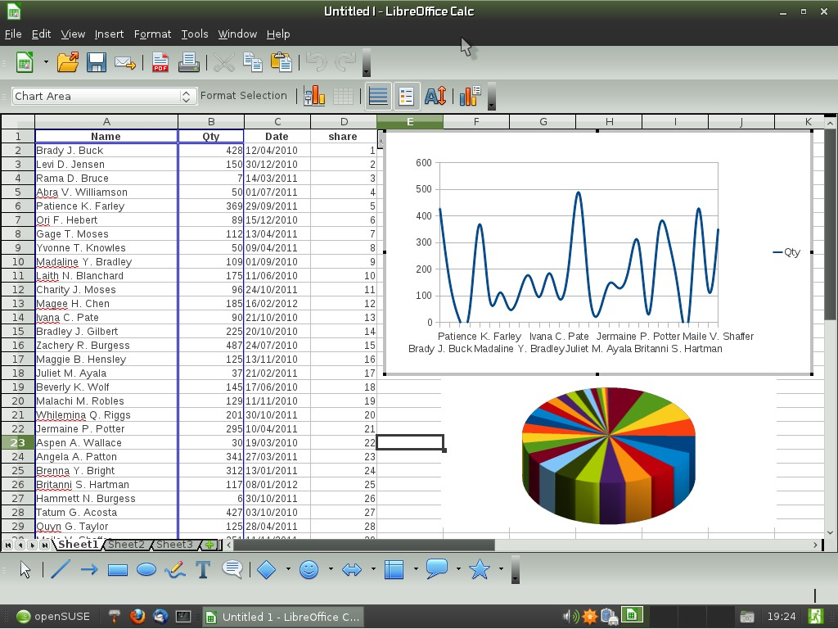
Notes:
LibreOffice 3.3.1 on XFCE 4.8 (SVG files in Draw, 1 million rows in Calc but real feature is community – Novell supports it heavily, openSUSE devs work on good integration!)
Koffice 2.3.1 Kpresenter: new slide sorter view and a shape animations tool. You can generate OpenDocument reports in KPlato and Kexi thanks to the KoReport library. OpenDocument support (esp text rendering) has been improved and also better support for reading MS files (doc, xls, ppt, docx, xlsx, pptx).

Slide 37
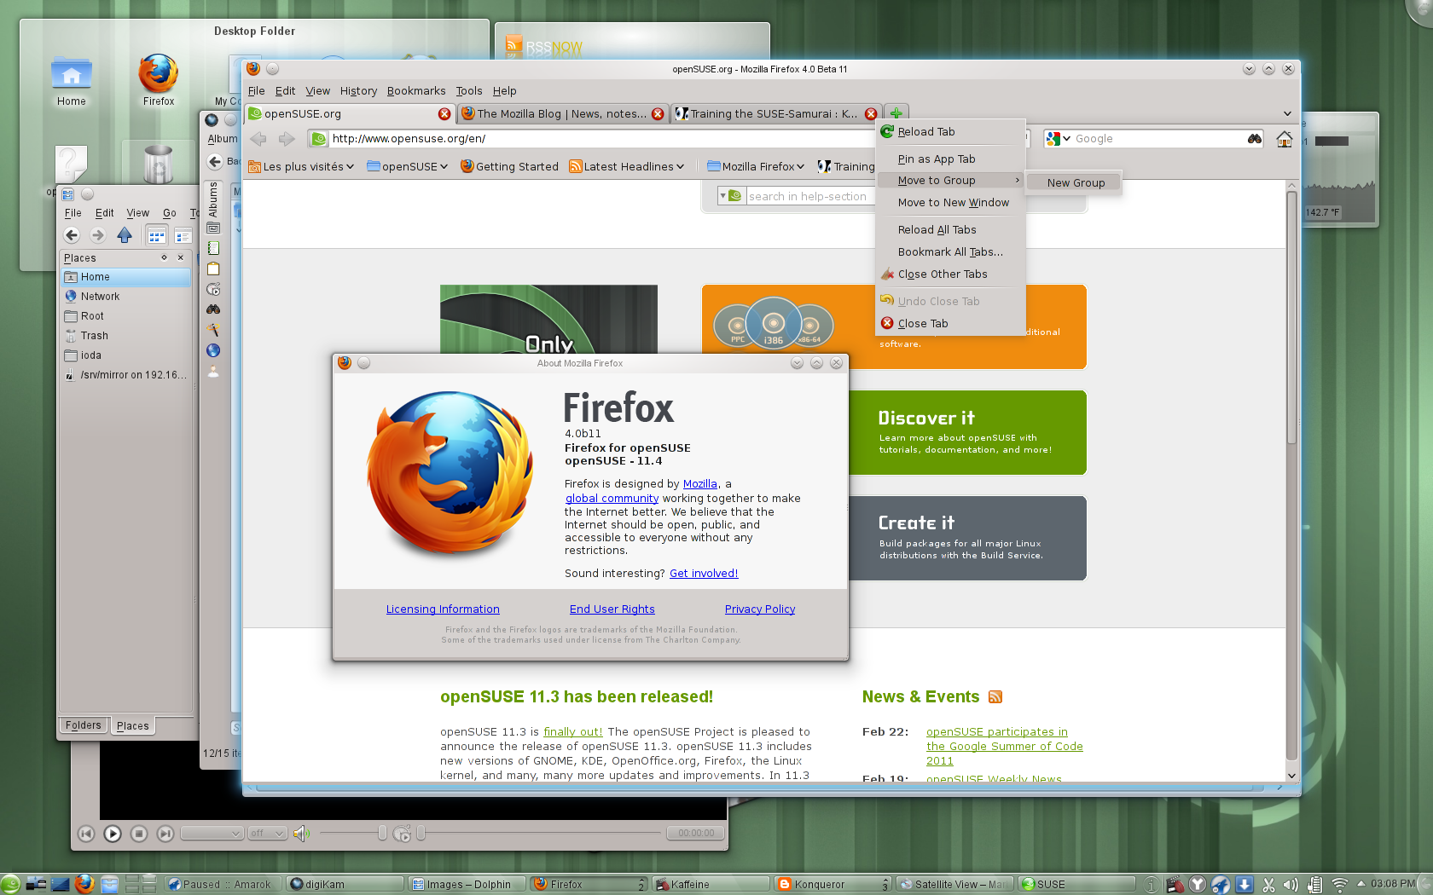
Notes:
Firefox 4.0 – new UI, better performance, Sync between Firefoxes
Other browsers – Google Chromium, Konqueror and ReKonq, Opera easy to install and others. Remember, choice!

Slide 38
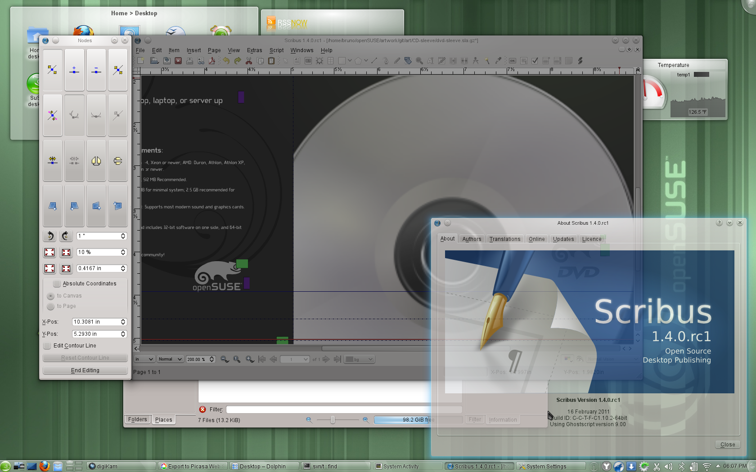
Notes:
Scribus 1.4.0 – Major rewrite, 1,5 year of work. Rewritten canvas (cairo), update to Qt4, usability.
Inkscape 0.48
* multipath editing
* improved text tool: subscript, superscript, numerical input for text kerning, tracking and more
* new Airbrush tool
* LaTeX export with PDF/PS/EPS
Krita 2.3 enduser ready. New features: brush settings presets, canvas rotation, warp transform, new color selector & new brush engines.

Slide 39
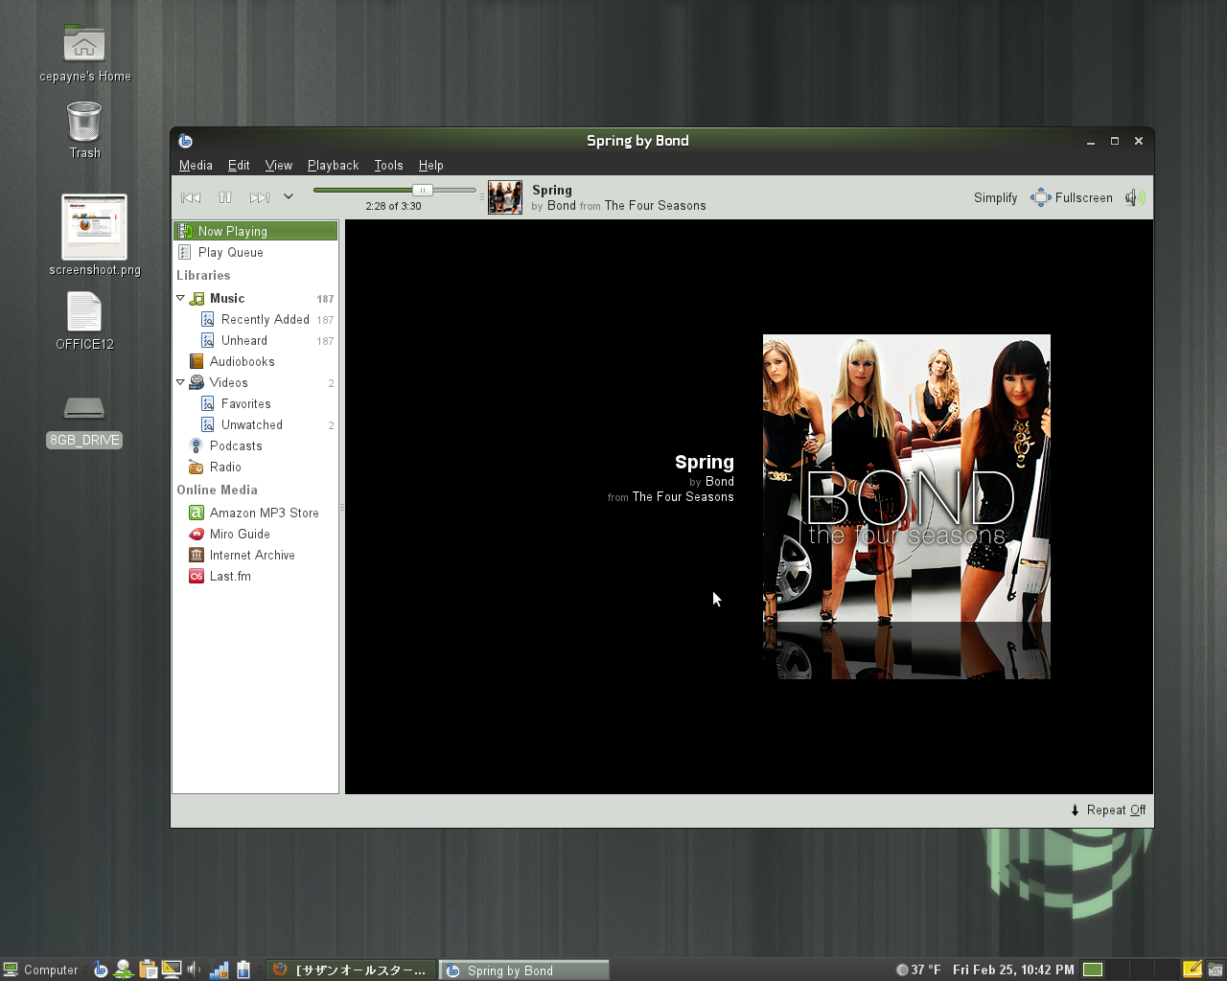
Notes:
Multimedia apps:
Media player Banshee 1.9.3 Now Playing simplify mode, play queue shuffle action, better downloading of cover art, MusicBrainz ID support and improved Last.FM integration. Finally, device support has been improved a lot. Among others, Banshee works more smoothly with the Droid X, Galaxy Portal, Xperia X10, Maemo and MTP devices in general.

Slide 40
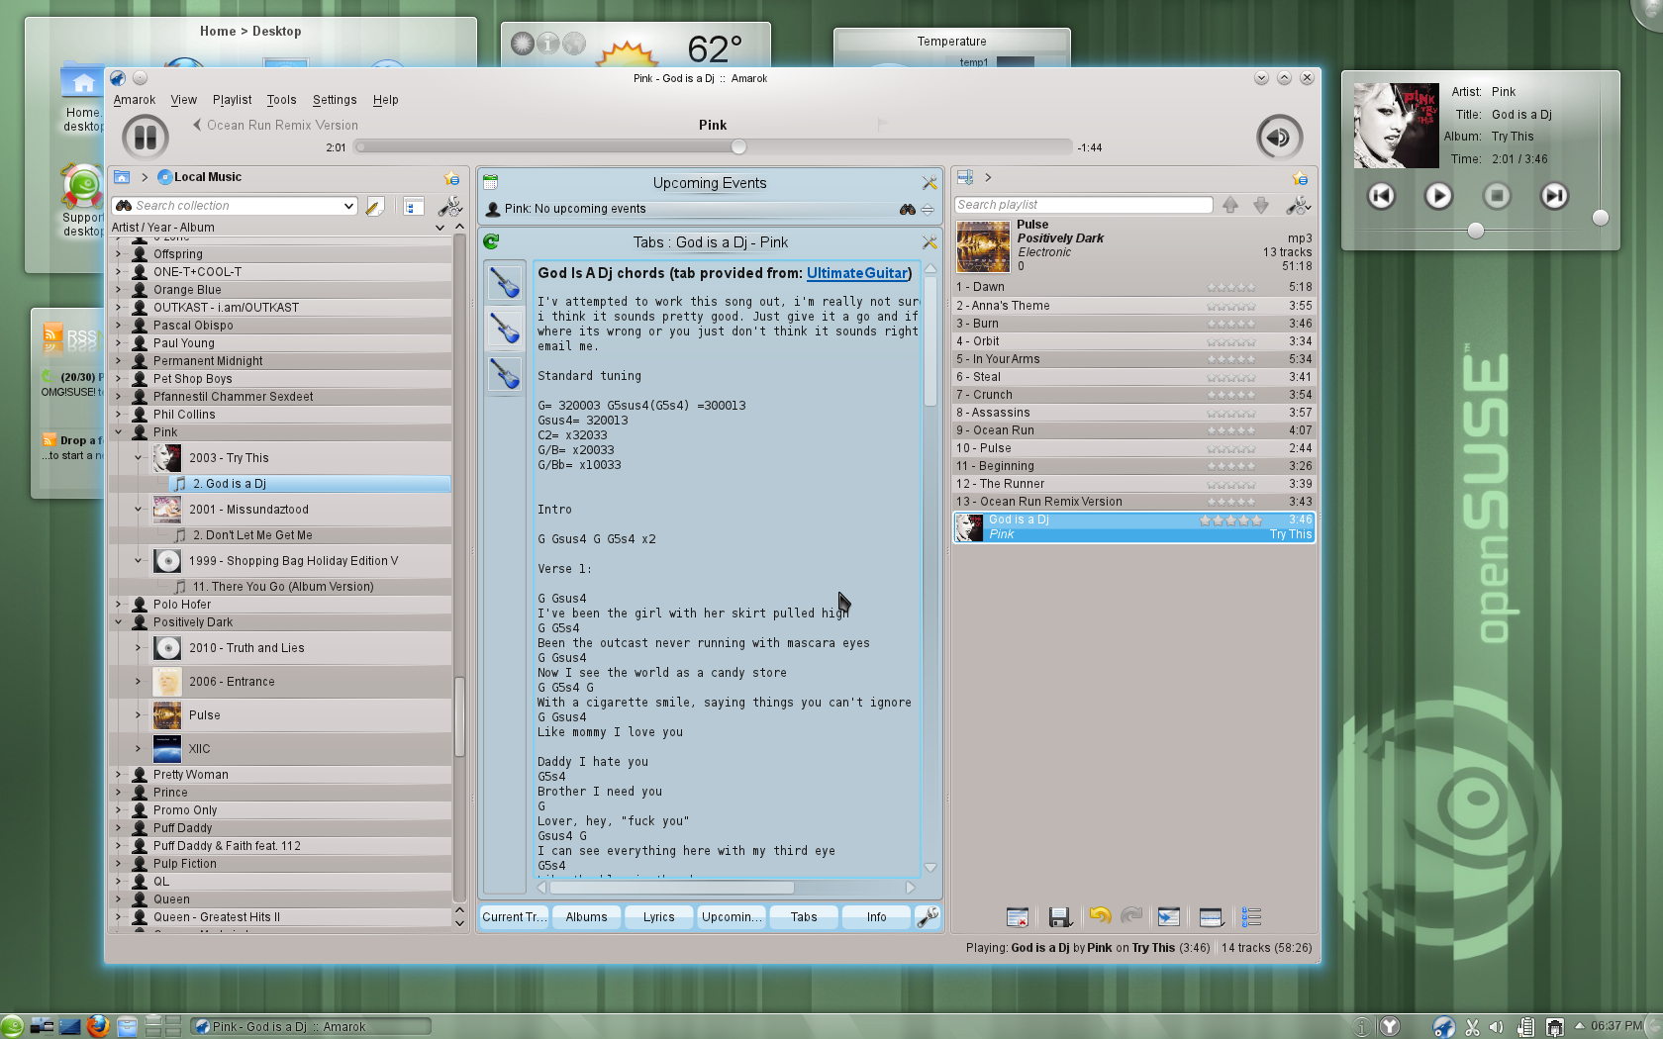
Notes:
Amarok 2.4.0 is faster, write to audio files, MusicBrainz tag retrieval, Guitar and Bass tab fetching, upcoming events, UpnP.
Rhythmbox 0.13.3 “Country Rain”: new context tab showing links to relevant websites with music info.
Clementine: new information panes show lyrics, song statistics, artist biographies, photos and lists of tags and similar artists. added ratings, play counts and skip counts. You can create smart and dynamic playlists from songs in your library, and also now listen to music from Jamendo and Icecast radio stations.
As usual: K3B, Brasero, Audacity and more are in 11.4!

Slide 41
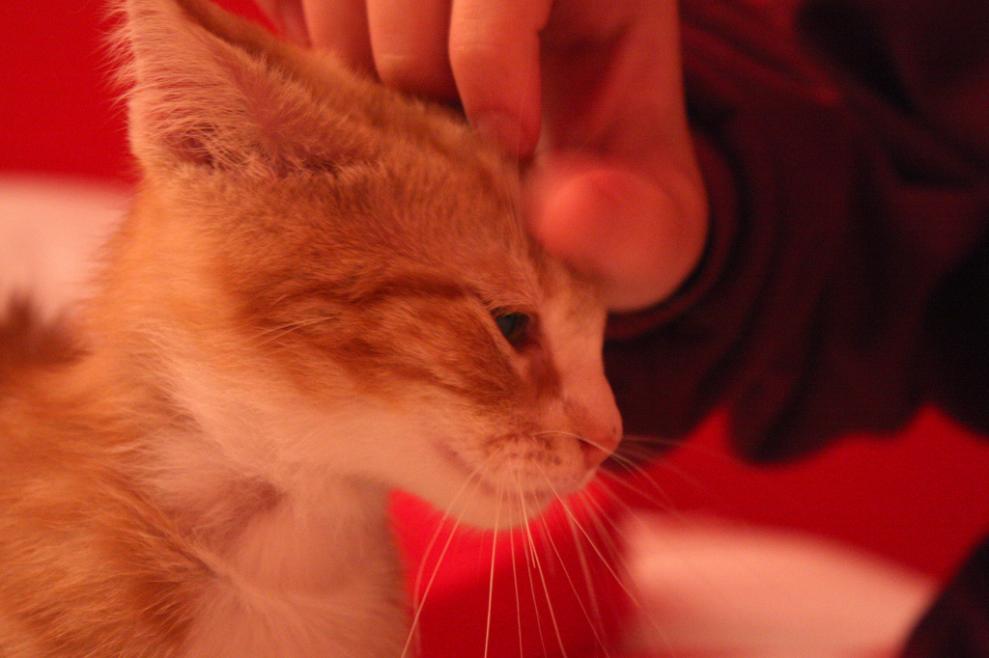
We take good care of sysadmins
Notes:
openSUSE offers everything a sys admin needs to get a server up, a network secured or a HPC workload finished.

Slide 42
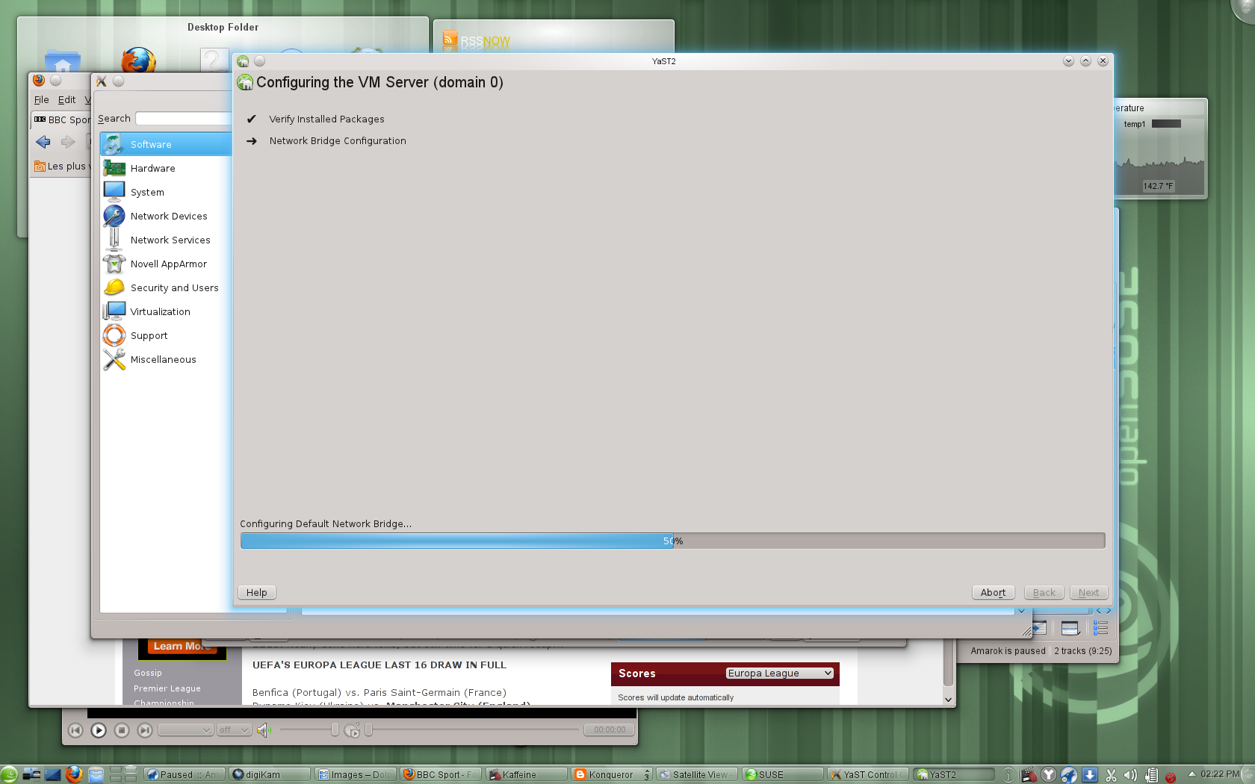
Notes:
openSUSE is great for virtualization. YaST makes management easy!
latest Xen, VirtualBox and KVM and integration with VMware and HyperV.
Xen: memory overcommit, Vmware workstation player/driver
Virtualbox: VMDK, VHD, and Parallels images supported, VHD and VDI can be resized; 32bit systems can use more than 2 GB of ram.
Introduction of open-vm-tools and virtualbox-guest-tools for easier management.

Slide 43

Notes:
YaST was awesome but now: WebYaST! All the power of YaST over a RESTful webservice, easy to use!
Network tools like WireShark 1.4, SMB Trafic Analyzer and everything for webservers:
Apache, lighttpd, Tomcat, nginx
MySQL, PostGRESQL, SQLite, MariaDB
Latest High Availability Clustering tools
New documentation on VMs, tuning etc

Slide 44
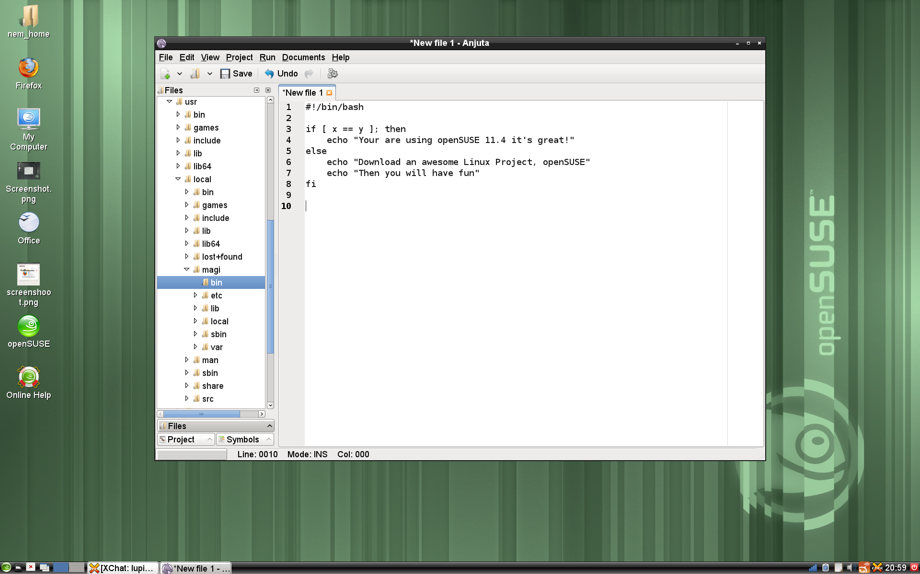
Notes:
OpenSUSE 11.4 is great for developers. We ship pretty much all IDE's (Anjuta, Geany, QtCreator, MonoDevelop, KDevelop, Eric, CodeBeans etc)

Slide 45
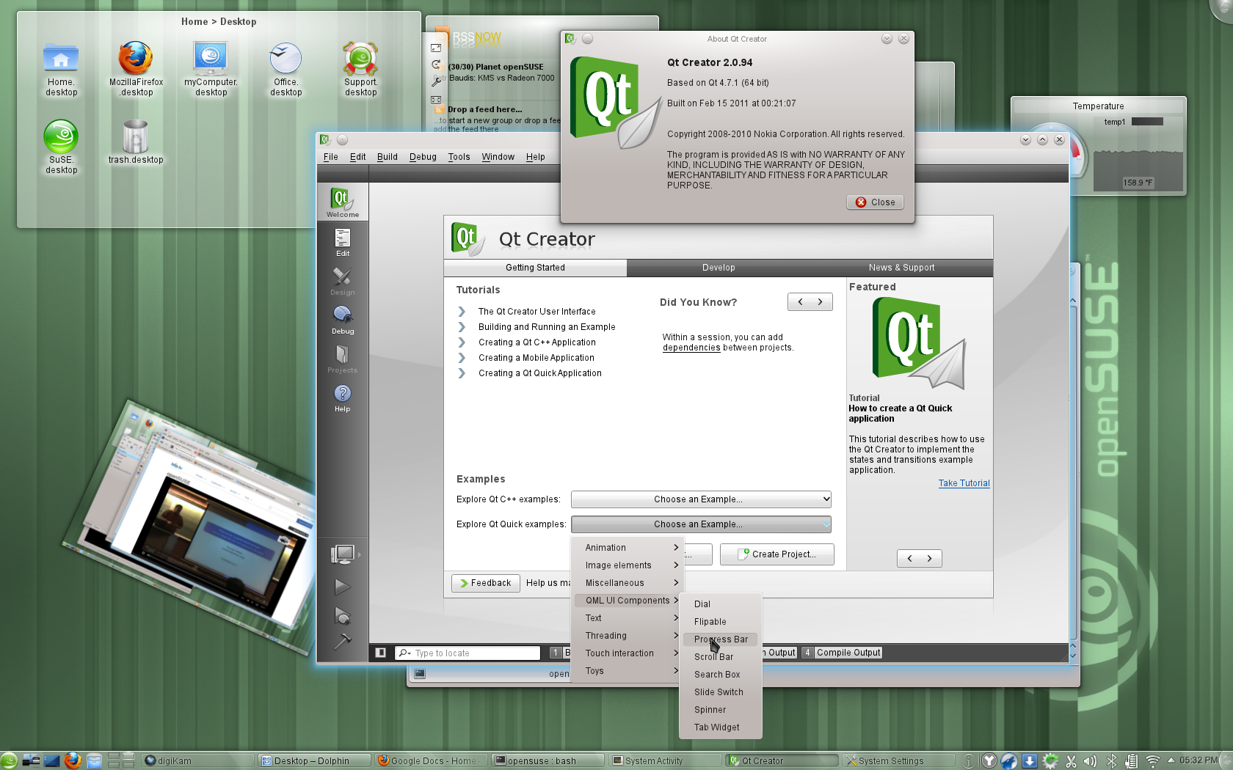
Notes:
We also have the latest KDE & Qt, GNOME 2.x AND 3.x libraries as well as Python, Ruby, Perl, Java and pretty much every other language.

Slide 46

Newcomers welcome
Notes:
You're more than welcome to come check openSUSE out!

Slide 47
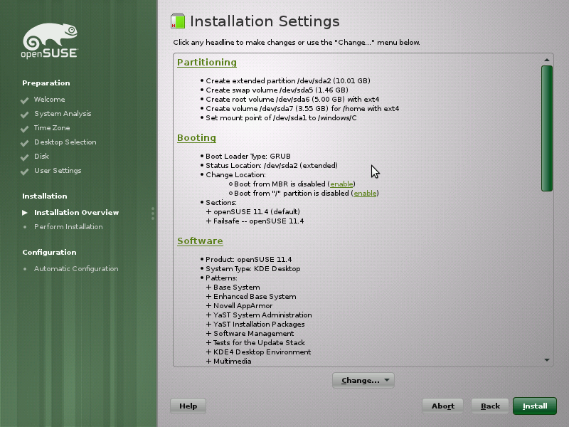
Notes:
openSUSE has a number of Live CD's and DVD's but is also quick and easy to install...

Slide 48
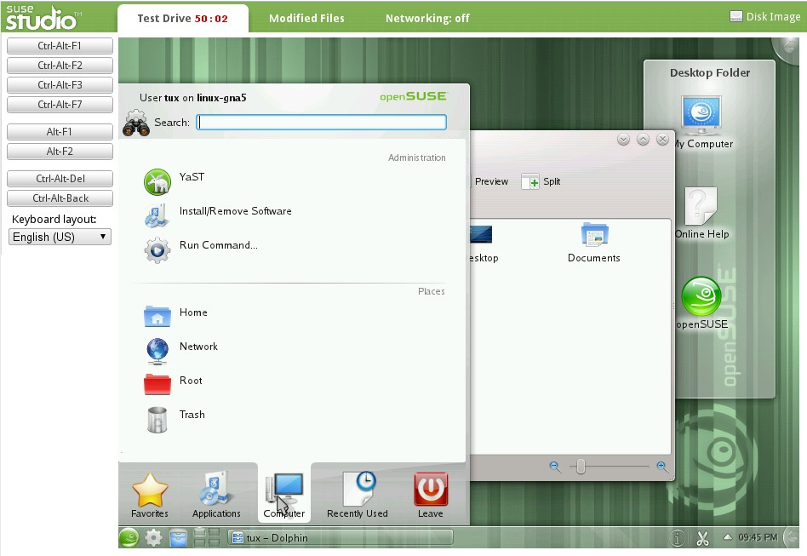
Notes:
If you want an even cooler way of testing, go to SUSEStudio.com and build your own OS and testdrive it directly from your web browser! It is free and easy. Once you're satisfied with the result you can download it as USB or CD live image or one of the VM options!

Slide 49

opensuse.org
planet.opensuse.org
opensuse.org/Portal:How_to_participate
opensuse.org/Junior_jobs
features.opensuse.org
build.opensuse.org
openhatch.org
#opensuse-project

Slide 50

Be a Geeko/Kitten
Notes:
Be the Geeko you can be!

Slide 51
Kitty and other Image credits
Plasma screenshot: Marco “notmart” martin
Tiling screenshot: Gene Kodadek
Other screenshots: openSUSE marketing team
Take care of sysadmins: sarah ross
Super kitty: malingering
Kittens in box: abcrumly
Be geeko/kitten: no idea...
To be found on Flickr under the above names with a Creative Commons license. Thanks all!

Slide 52
Your next Linux Distribution!
Notes:
So, the question you should be asking is not “what does openSUSE have that I need?” but “what does openSUSE NOT have that I need?” and the answer is most likely: nothing. After all, our OBS provides well over 100.000 different packages made by over 25.000 people. All that you can get easily through Zypper and YaST! Moreover, you can use KIWI (or the web interface SUSE Studio) to build your own openSUSE based operating system. We have projects like Tumbleweed, Appstream and Bretzn – we do so much cool stuff it's hard to keep track of it.
In short, openSUSE is much more than a linux distribution. 11.4 is awesome, but thanks to the other things the openSUSE Project does, no other linux distro can beat it!
Thank you for listening.

